Slide 1

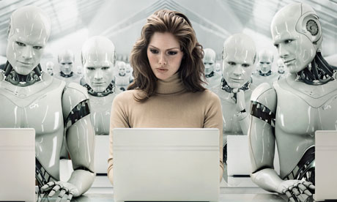
Princess Nora Bint Abdulrahman University
College of Computer Science and Information
CS101
Robotics
by:
Bayader Aloliwi - 432000217
Lujain Alkhalifa - 432007843
Yara Alnghimshi - 432008375

Slide 2
Outlines
Definition
History
How Do Robots Work?
Advantages.
Disadvantages.
Robots Applications
World Famous Robots
Conclusion
References

Slide 3
Definition
‘What is a Robot?’
Device works automatically.
Reprogrammable, multifunctional.
Variety of tasks.
Artificial Intelligence.

Slide 4
History (1-2)
known after the twenties (last century)
Greeks first began idea.
‘1495’ humanoid robot.
‘1700-1900’ famous mechanical duck

Slide 5
History (2-2)
‘1932’ first true robot.
‘1941’ Isaac Asimov.
‘1950’ reproduced as a movie.

Slide 6
How do Robots Work?
Robot must include three key aspects :
Sensing
Planning
Interaction (Act)

Slide 7
Advantages (1-2)
More accurate than humans.
Keep doing the same thing 24/7.
Lift very heavy things.
They can’t harm you unless they are programmed to.

Slide 8
Advantages (2-2)
Can’t harm you.
No need for nutrients.
Go to very dangerous places.

Slide 9
Disadvantages (1-2)
Need to get people trained to fix them
Take humans jobs
High cost to make them.
Hard to program.

Slide 10
Disadvantages (2-2)
Some materials to make them could be rare.
Need a very intelligent crew.
They cannot recharge themselves

Slide 11
Robots Applications
Industry.
Intelligent Systems.
Recreations and Sports.
Medicine.
Space.
Underwater.

Slide 12
World Famous Robots: (1-4)
1.Asimo:
Asimo is a humanoid robot created by Honda in Japan.
Refers to “Advanced Step in Innovation Mobility”.
the robots like an astronaut wearing a backpack.
Figure1: Asimo

Slide 13
World Famous Robots: (2-4)
2.Kismet:
A robot made in 1990s.
The name means “fate” or “luck”.
Facial expressions are like movements.
Contains input devices.
The cost is about US$25,000.
Figure2: Kismet

Slide 14
World Famous Robots: (3-4)
3. iCub:
A small-sized humanoid robot.
Designed by the Robot Cup Consortium.
The main goal is to study cognition .
Figure3: iCub

Slide 15
World Famous Robots: (4-4)
4. Actroid
A humanoid robot developed by Osaka University.
Different versions have been produced.
Appearance is like a woman
It can mimic lifelike functions
Figure4: Actroid

Slide 16
Conclusion
Robots are useful in many ways.
Cannot perform every job.
Scientists are developing robots.
Future:
will be new ways to use robots

Slide 17
References
[1] Seraj. (2010, Des 27), “What do you know about robots”, Roblogia.[online].
Available: http://www.robologia.com/2010/about-robot/
[2] Wikipedia. (2011, May 5) “Robotics”, (Wikipedia). [online].
Available: http://en.wikipedia.org/wiki/Robotics
[3] sciencekids. (2012)," The History of Robotics ".sciencekids. [Online]
Available: http://www.sciencekids.co.nz/sciencefacts/technology/historyofrobotics.html
[4] Carey, D. (2009, June 9), “How do Robots work”, Life123.[online].
Available: http://www.life123.com/technology/computer-hardware/robots/how-do-robots-work.shtml
[5] KACST (2012), “Robots Applications”, King Abdulaziz City for Science and Technology.[online]
Available: http://www.kacst.edu.sa/en/depts/NCRIS/Pages/research.aspx
[6] Jitendra. (2012, April 21), “World Famous Robots“ ,Jitu Technology.[online]
Available: http://www.jitutechnology.com/word-famous-robots/

Slide 18
Questions?

